Slide 1
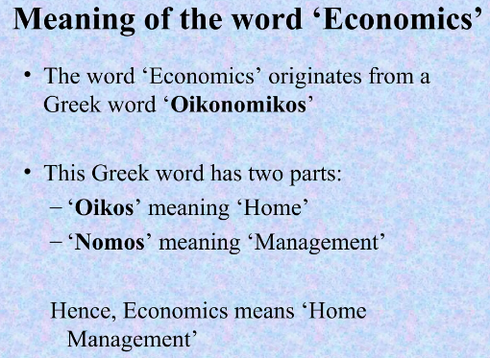

Slide 2
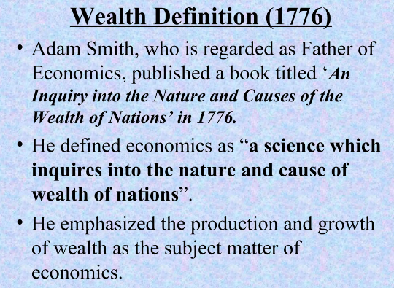

Slide 3
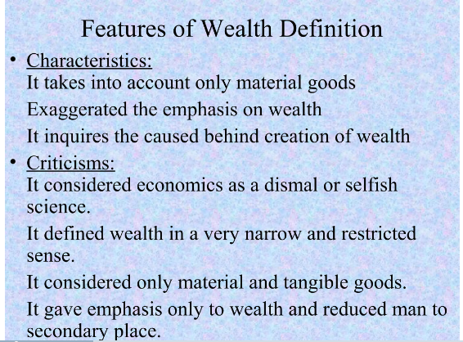

Slide 4


Slide 5


Slide 6
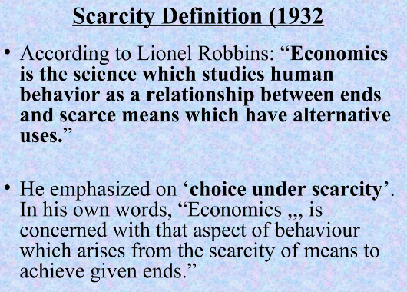

Slide 7

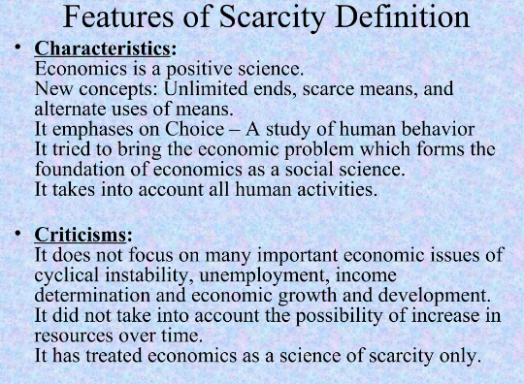

Slide 8
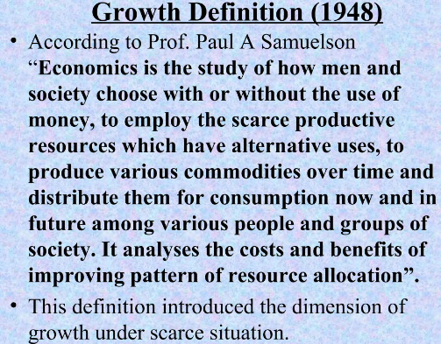

Slide 9
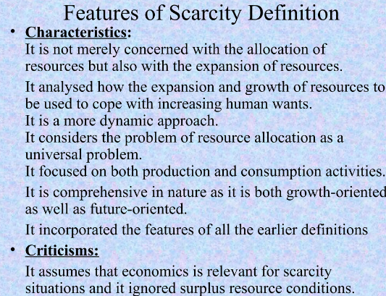

Slide 10
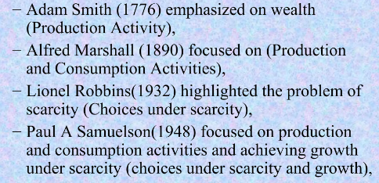

Slide 11

Difference between Micro and Macro Economics

Slide 12
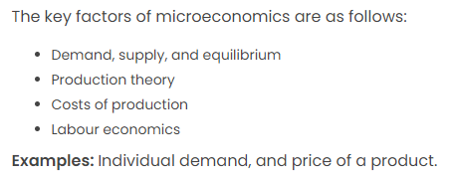


Slide 13
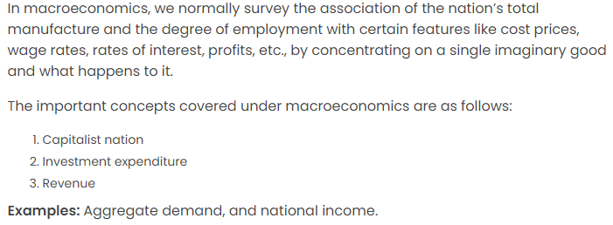

Slide 14
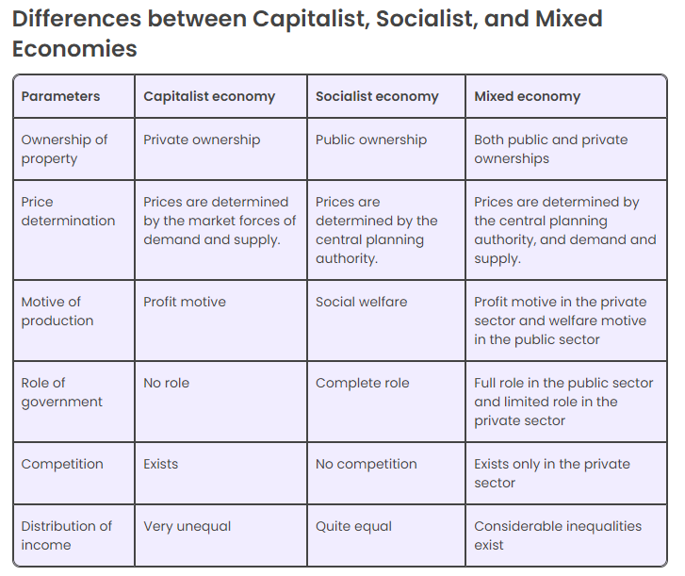

Slide 15


TYPES OF ECONOMIC SYSTEM
Features Of Capitalism

Slide 16



Slide 17

Socialist Economy
Features Of Socialist Economy

Slide 18


Slide 19

Mixed Economy
Features Of Mixed Economy

Slide 20


Slide 21



Slide 22



Slide 23
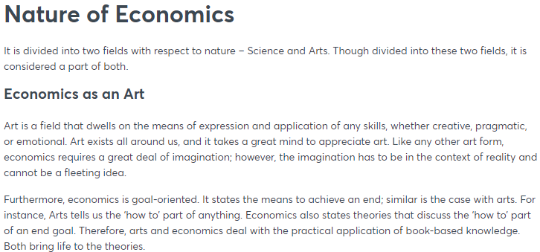

Slide 24
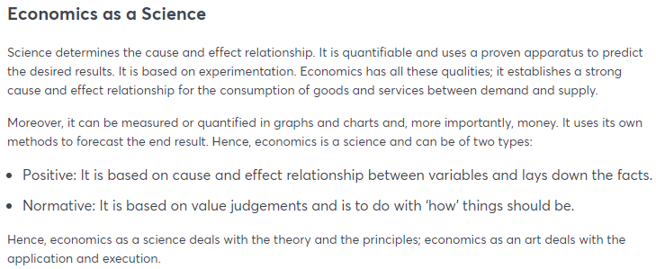

Slide 25



Slide 26




Slide 27


