Slide 1

General English-I
Mustafa M. Pathan
M. A. [English] B. Ed. LL.B. PGDM
+917378681000
+917378683000

Slide 2

Tenses in English
There are three main tenses in English.
The Present
The Past
The Future
The tense of a verb shows the time of an action or event.

Slide 3
Tenses in English
These three tenses have four sub-types of each
Simple
Continuous
Perfect
Perfect Continuous

Slide 4


Present Tense
Simple Present
Use
This tense is used
To express actions done as matter of habits/ repeatedly / daily routines
Scientific facts Universal truths
in newspaper headlines

Slide 5
Simple Present Tense
Form : subject + am/is/are + complement
Example : I am a teacher .
You are students.
She is an Advocate.
Negative : subject + am/is/are + not + complement
Example : I am not a teacher .
You are not students.
She is not an Advocate.
Interrogative : am/is/are + subject + complement ?
Example : Am I an advocate ?
Are you students?
Is she clever?

Slide 6

Simple Present Tense
Form : subject + have / has + complement
Example : I have three sisters.
He has one brother.
Negative : subject + do / does + not + have + complement
Example : I do not have any brother.
She does not have any sister.
Interrogative : do / does + subject + have + complement ?
Example : Do you have extra pen?
Does she have computer in her office?

Slide 7
Simple Present Tense
Form : subject + V (base form / +s/+es) + object / complement
Example : I teach English.
He works in government hospital.
She teaches Economics.
Negative : subject + do / does + not + V(I) + object /complement
Example : I do not teach Political Science.
She does not work here.
Interrogative : do / does + subject + V(I) + object /complement?
Example : Do I teach English?
Does she work here?

Slide 8
Simple Present Tense
Examples : Monkeys eat bananas.
Sun rises in the East .
Water boils at 100°C.
Food prices touch a new height.
He practises in the Bombay High Court.
Industrial wastes pollute the atmosphere.

Slide 9

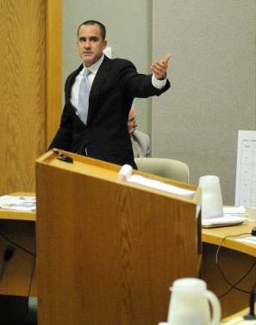
Present Continuous Tense
Form : subject + am/is/are +V (+ing) + object / complement
Example : I am teaching Tenses.
You are learning grammar.
Someone is making noise outside.
Negative : subject + am/is/are +not+ V (+ing) + object / complement
Example : I am not using blackboard.
We are not studying Economics now.
She is not paying attention in the class.
Interrogative : am/is/are +subject + V (+ing) + object / complement?
Example : Am I using blackboard today?
Are we studying Tenses today?
Is he coming to party tonight?

Slide 10

Present Continuous Tense
Use
This tense is used
To denote an action happening at the time of speaking.
Example: It is raining now.
2. To express a definite programme in the near future.
Example: We are shifting to our new house next week.

Slide 11

Exercise
Fill in the blanks using appropriate form of verbs given in the brackets.
“Sometimes, when we….. (get) hurt, the bleeding …….(not stop). Why …. (do) this happen?” Asked Raju. “ Let me explain how bleeding ……(stop)” said the doctor. “ First, the blood vessels …….(tighten) and this ……..(lessen) the flow of blood. Next, the blood platelets ….. (clamp) together and ….(try) to plug the breach.
Some substances present in the plasma also ……(help) in the process. When the wound ….(be) very deep, the blood vessels … (not tighten ) easily and the bleeding ……(not stop). If this …….. (happen), a doctor tightly ….. (wrap) a bandage over the wound to apply external pressure on it.”

Slide 12
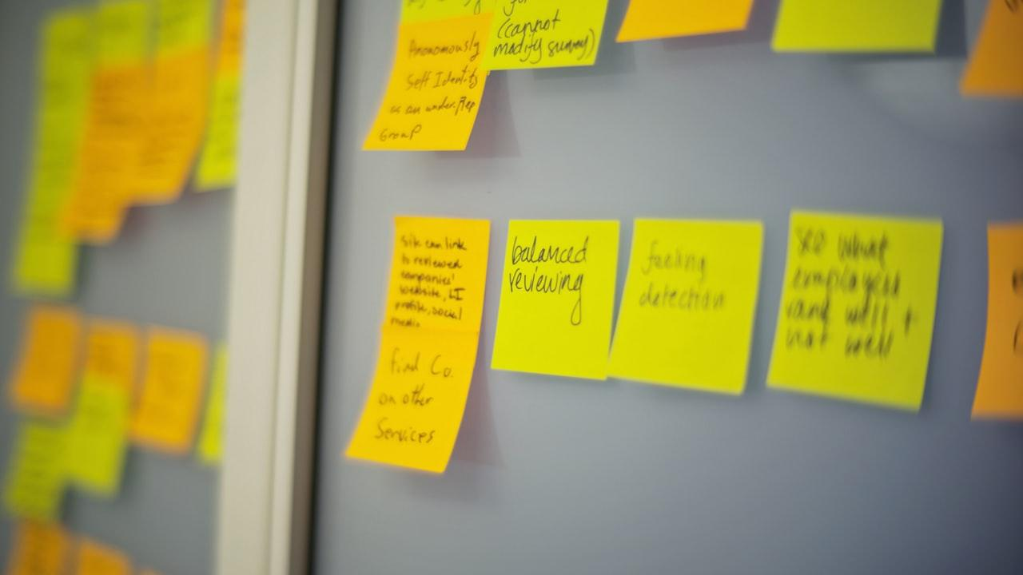
Present Perfect Tense
Form : subject + have / has +V (past participle) + object / complement
Example : We have finished two tenses.
She has completed all the assignments.
Negative : subject + have / has +not + V (past participle) + object / complement
Example : We have not finished all the tenses.
She has not completed the assignment yet.
Interrogative : have / has +subject + V (past participle) + object / complement?
Example : Have we finished the tenses?
Has he submitted any new evidence?

Slide 13
Present Perfect Tense
Uses: Present perfect tense is used to express an action –
a) very recently completed.
For example: They have just arrived.
b)occurred in the past but whose effects can be felt at the moment of speaking
For example: I have had my lunch. (I’m not hungry now)
I have already applied. (I need not apply now)

Slide 14
Present Perfect Continuous Tense
Form : subject + have / has + been + V (+ing) + object / complement
Example : We have been studying tenses for two weeks.
He has been teaching tenses since last month.
Negative : subject + have / has +not + been + V (+ing) + object / complement
Example : We have not been studying tenses for two weeks.
He has not been teaching tenses since last month
Interrogative : have / has +subject + been+ V (+ing) + object / complement?
Example : Have we been studying tenses for two weeks?
Has he been teaching tenses since last month?

Slide 15
Present Perfect Continuous Tense
Use
This tense is used to express an action that began in the past, is in progress at the time of speaking and will extend into the future.
I have been teaching English for eighteen years.
I have been teaching English since 2005.
It has been raining since early morning.
They have been living in Latur for last 5 years.

Slide 16
Simple Past Tense
Form : subject + was/were + complement
Example : He was in Mumbai yesterday.
They were sad.
Negative : subject + was/were + not + complement
Example : She was not happy.
We were not present in the class at that time.
Interrogative : was/were + subject + complement ?
Example : Was he there in the class?
Were they really happy about it?

Slide 17
Simple Past Tense
Form : subject + had + complement
Example : King had three sisters.
Negative : subject + did + not + have + complement
Example : Queen did not have any brother.
Interrogative : did + subject + have + complement ?
Example : Did he have any siblings?

Slide 18
Simple Past Tense
Form : subject + V (II form) + object / complement
Example : He played football.
She attended all the classes.
We studied present tense.
Negative : subject + did + not + V(I) + object /complement
Example : He did not play football.
They did not attend the programme.
Interrogative : did + subject + V(I) + object /complement?
Example : Did he come to class yesterday?
Didn’t they cheat in the exam?

Slide 19
Simple Past Tense
Uses : Past simple is used to express an action-
a) that took place at some point of time in the past.
b) habitual actions / daily routines in the past.

Slide 20
Past Continuous Tense
Form : subject + was /were +V (+ing) + object / complement
Example : She was watching TV.
They were playing cricket in the street.
Negative : subject + was/were +not+ V (+ing) + object / complement
Example : I was not studying at that time.
We were not playing with them.
Interrogative : was/were +subject + V (+ing) + object / complement?
Example : was he studying at that time?
were they playing cricket in the street?

Slide 21
Past Continuous Tense
Uses : Past continuous tense is used to express an action-
a) that was in progress at some point of time in the past.

Slide 22
Past Perfect Tense
Form : subject + had +V (past participle) + object / complement
Example : We had given first aid to the patient before the doctor arrived.
The match had started before we reached the playground.
Negative : subject + had +not + V (past participle) + object / complement
Example : We had not given first aid to the patient when the doctor arrived.
The match had not started when we reached the playground.
Interrogative : had + subject + V (past participle) + object / complement?
Example : Had they given first aid to the patient before the doctor arrived?
Had the match started when you reached the playground?

Slide 23
Past Perfect Tense
Uses: Past perfect tense is used to express an action completed before a given
moment in the past.

Slide 24
Past Perfect Continuous Tense
Form : subject + had + been + V (+ing) + object / complement
Example : The CBI had been investigating the case for two years when Mr. Reddy
took over as its Director General.
Negative : subject + had +not + been + V (+ing) + object / complement
Example : The police had not been doing anything for two years.
Interrogative : had +subject + been+ V (+ing) + object / complement?
Example : Had the police been investigating the case seriously?

Slide 25
Past Perfect Continuous Tense
Use
This tense is used to express an action which began before a certain point in the past and continued up to that time.
I left Libya in 2017. Before that, I had been teaching English in Libya for ten years.

Slide 26
Simple Future Tense
Form : subject + shall/will + V(I form) + object / complement
Example : We shall study the voice in the next class.
Negative : subject + shall/will+ not + V(I form) + object /complement
Example : He will not teach you tomorrow.
Interrogative : shall/will + subject + V(I form) + object / complement ?
Example : Shall we study this topic next week?

Slide 27
Simple Future Tense
Use : Simple future tense is used to talk about what we think will
happen in the future.
Example : We shall have final exam next month.
She will travel to Mumbai tomorrow.
Use : Simple future tense is used to offer to do something.
Example : I’ll help you to pack your luggage.
Use : Simple future tense is used to promise to do something.
Example : I’ll take you to all to Bombay High Court next semester.
Use : Simple future tense is also used for making request, suggestion etc.
Example : Will you get me a glass of water, please?
Shall I explain the route to you?
Shall we send these letters by speed post?

Slide 28
Simple Future Tense
Other Forms : going to (to talk about intentions, planning)
Example : We are going to shift to a new house next week.
She is going to buy a new car next month.
Other Forms : simple present tense to show future
Example : The Rajdhani Express leaves for Kolkata at five in the evening.
Our semester-end exam begins next month.

Slide 29
Future Continuous Tense
Form : subject + shall/will + be+ V(+ing) + object / complement
Example : At this time tomorrow, I shall be watching FIFA semi-final
between Argentina and Croatia.
Negative : subject + shall/will+ not + be+ V(+ing ) + object /complement
Example : At 11.30 pm, he will not be studying but watching the match.
Interrogative : shall/will + subject+ be+ V(+ing) + object / complement ?
Example : will they be auctioning these goods next Friday?

Slide 30
Future Continuous Tense
Use: we use this tense to express an action which will be in progress at a given time in future.

Slide 31
Future Perfect Tense
Form : subject + shall/will + have+ V(III or past participle form) + object / complement
Example : They will have computerized their entire working by this year end.
Negative : subject + shall/will + not + have+ V(III form) + object / complement
Example : by 6pm tonight, She will not have cooked the dinner.
Interrogative : shall/will +subject + have+ V(III form) + object / complement ?
Example : will you have studied all the English verb tenses by next year?

Slide 32
Future Perfect Tense
Use: we use this tense to talk about actions that will be
completed by a certain future time.

Slide 33
Future Perfect Continuous Tense
Form : subject + shall/will + have+ been + V(+ing form) + object / complement
Example : when the clock strikes 10, I’ll have been writing these letters for two hours.
Negative : subject + shall/will + not + have+ been + V(+ing form) + object / complement
Example : We’ll not have been studying English after two years.
Interrogative : shall/will + subject + have+ been + V(+ing form) + object / complement ?
Example : will they have been living in Mumbai from 2025 onwards?

Slide 34
Future Perfect Continuous Tense
Use: we use this tense for actions which will be in progress over a period of time in future.

